Slide 1
Capstone Project 3 CYCLIST BIKE SHARE ANALYSIS
Presented By:
Laksmi Priya M
MBM6

Slide 2
A STATEMENT OF BUSINESS TASK
Cyclistic, a bike-share company, aims to transition casual riders into annual members by understanding and leveraging usage patterns and customer behavior.

Slide 3
A Description Of All Data Source
For the analysis of Cyclistic's bike-share data, the primary data source is the ride logs provided by Cyclistic. These data contain detailed information about each ride taken on the bike-share system, ride type. Here is a description of the key data sources and their components:
Primary Data Source: Cyclistic Ride data
File Type: CSV File
Key Columns:
ride_id: Unique identifier for each ride.
rideable_type: Type of bike (e.g., electric, docked).
started_at: Timestamp indicating when the ride started.
ended_at: Timestamp indicating when the ride ended.
start_station_name: Name of the station where the ride started.

Slide 4
start_station_id: Unique identifier for the start station.
end_station_name: Name of the station where the ride ended.
end_station_id: Unique identifier for the end station.
start_lat: Latitude of the start station.
start_lng: Longitude of the start station.
end_lat: Latitude of the end station.
end_lng: Longitude of the end station.
member_casual: User type, indicating whether the rider is a casual rider or an annual member.

Slide 5
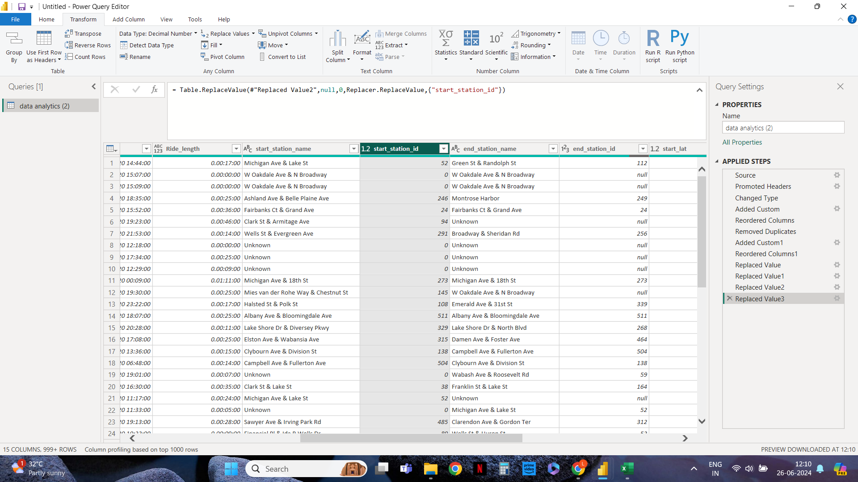
Documentation Of Cleaning and Manipulation Of Data

Slide 6
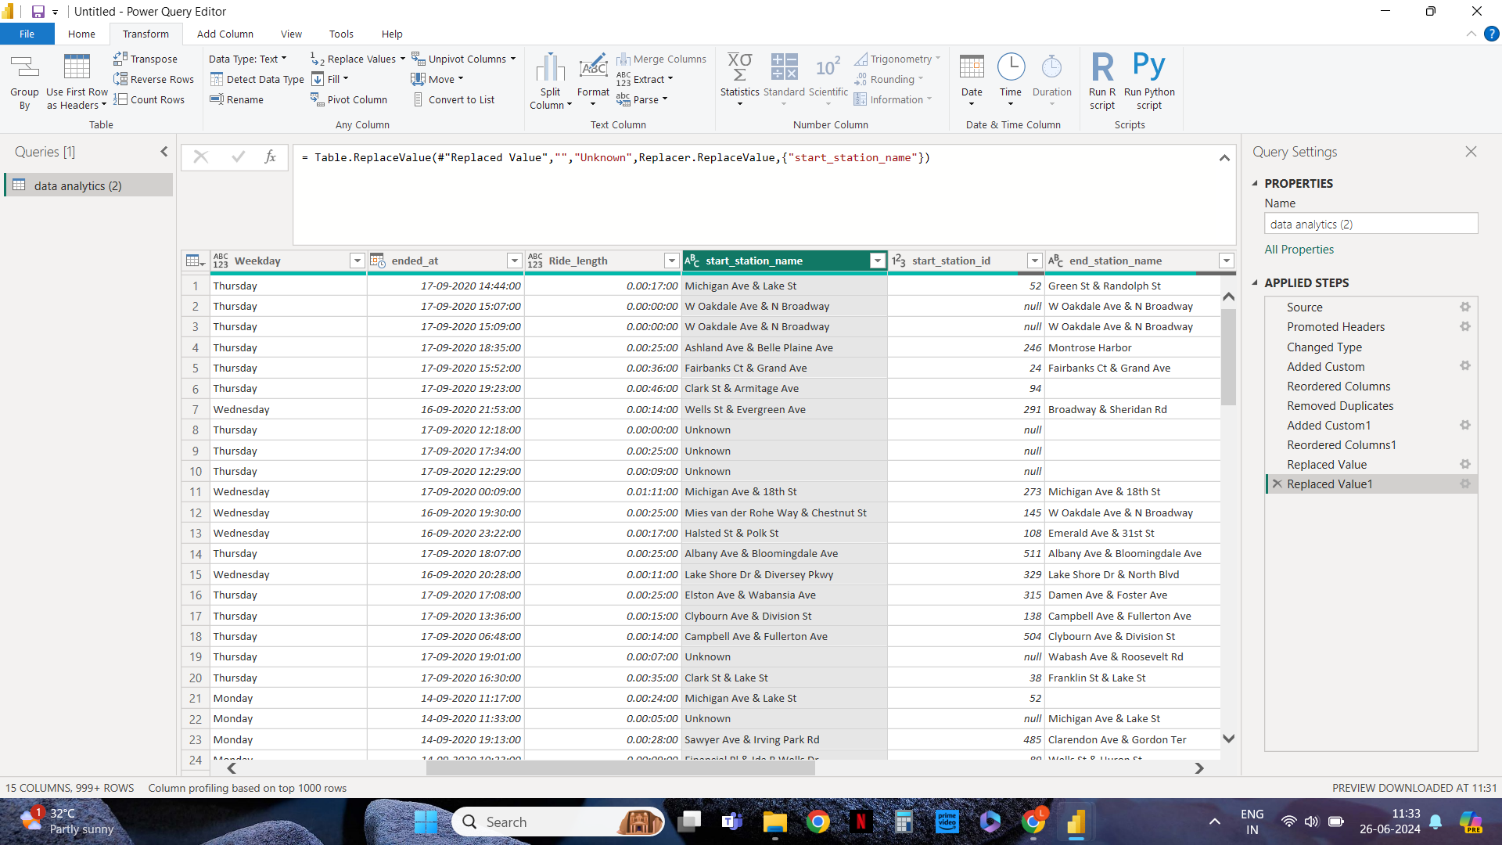
Documentation Of Cleaning and Manipulation Of Data - Cntd

Slide 7
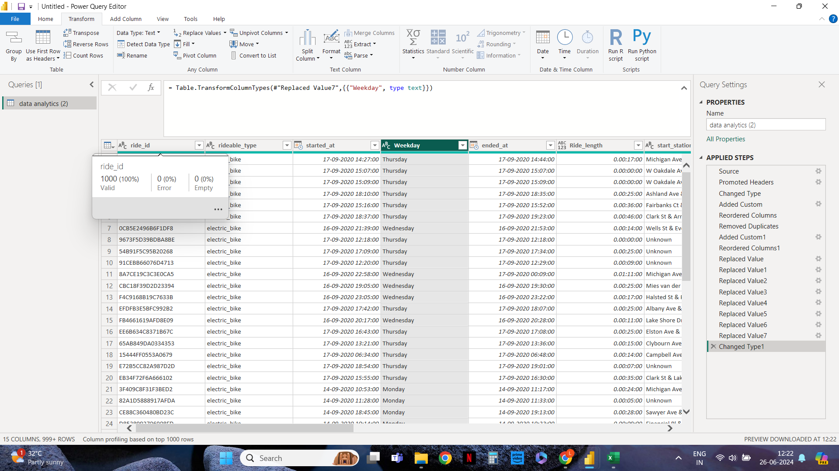
Documentation Of Cleaning and Manipulation Of Data - Cntd

Slide 8
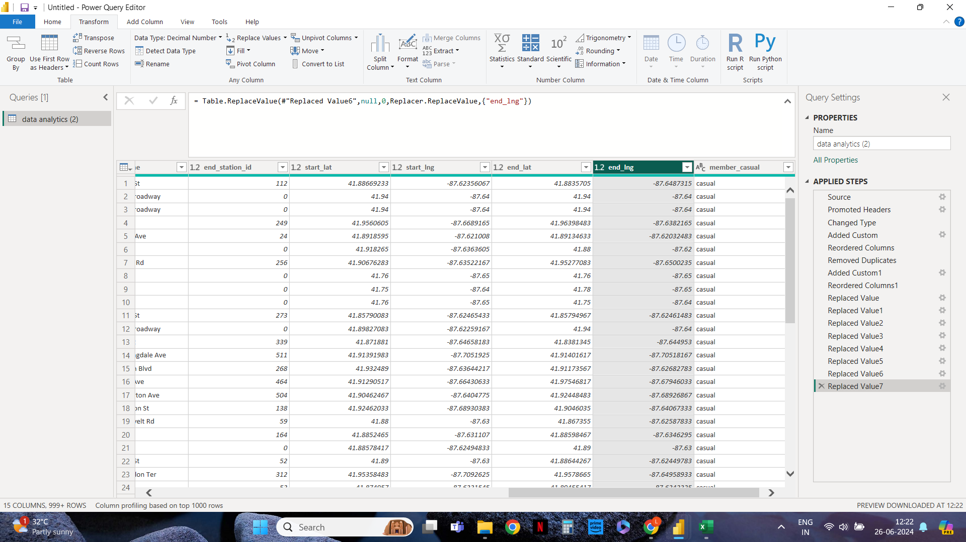
Documentation Of Cleaning and Manipulation Of Data - Cntd

Slide 9
A Summary Of Your Analysis
Objective
The primary objective of the analysis is to identify key usage patterns, trends, and relationships in Cyclistic's bike-share data to inform strategic decisions aimed at increasing annual memberships and improving user satisfaction.
Key Steps in the Analysis
Data Preparation and Cleaning:
Imported the Cyclistic ride data.
Cleaned the data by removing duplicates and handling missing values.
Ensured proper data types for all fields.
Created a new column Ride_length, Weekday to calculate the duration of each ride and to know the start_station_id weekday.

Slide 10
Exploratory Data Analysis (EDA):
Examined the distribution of rides by start and end times, ride duration, and user type.
Aggregated the data with Avg, Sum functions to calculate Avg ride_length by member_casual,
Trend Analysis and Relationship:
Analyzed user rideable_type.
Created a matrix visualization to identify the most common start and end station combinations.
Conclusion:
The analysis of Cyclistic's bike-share data reveals important insights into user behavior, ride patterns, and station popularity.

Slide 11
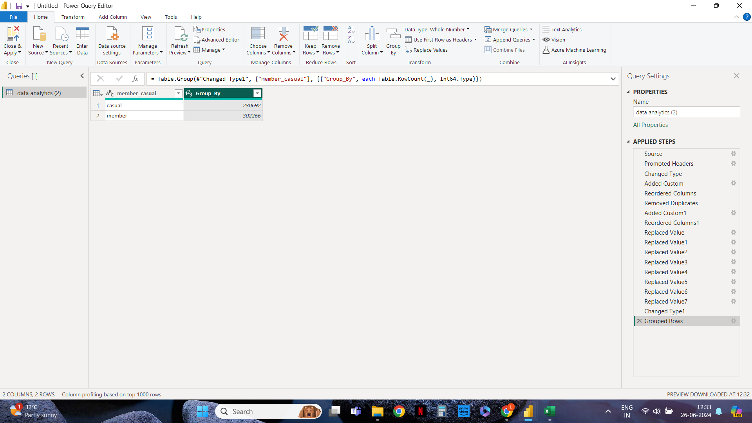
Supporting visualizations and key findings
Group By:

Slide 12
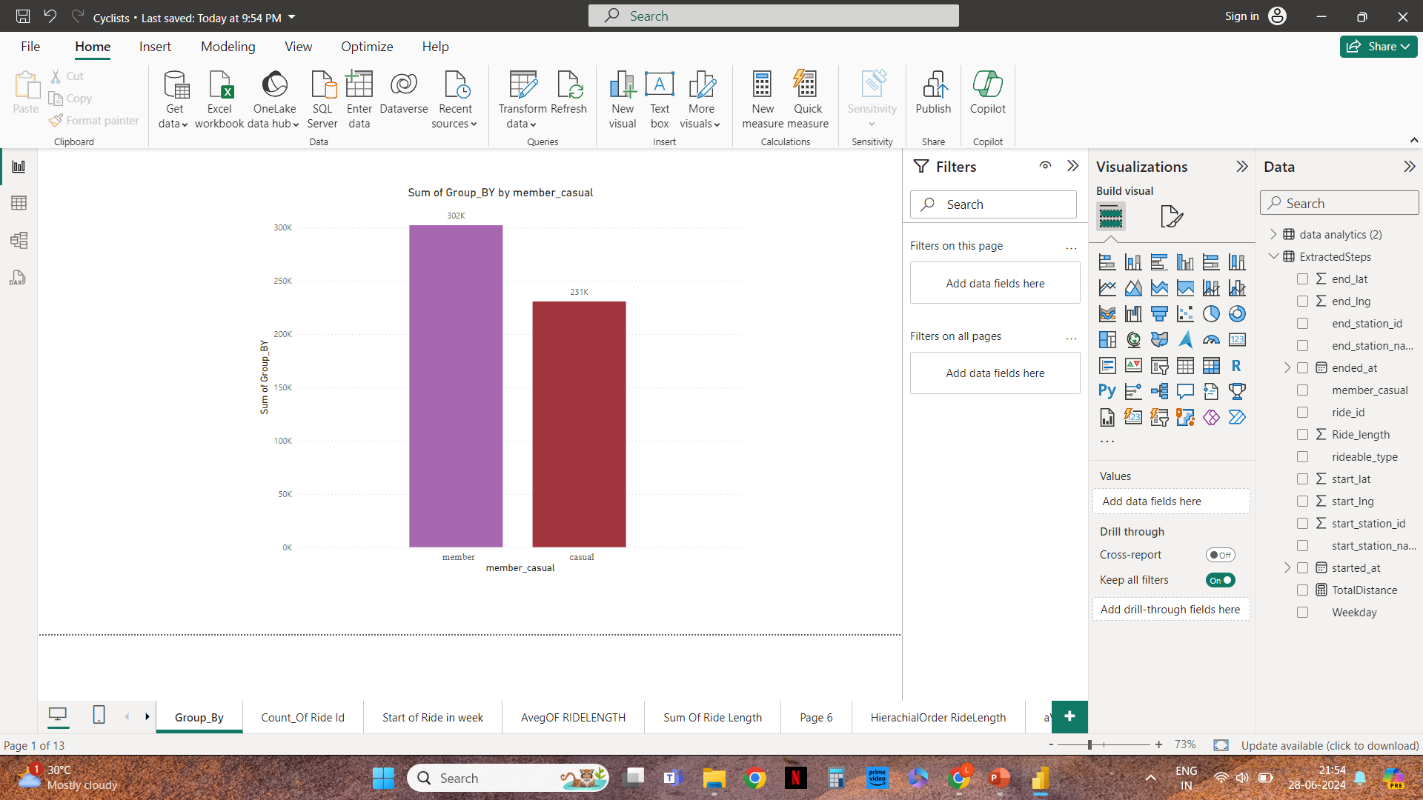

Slide 13
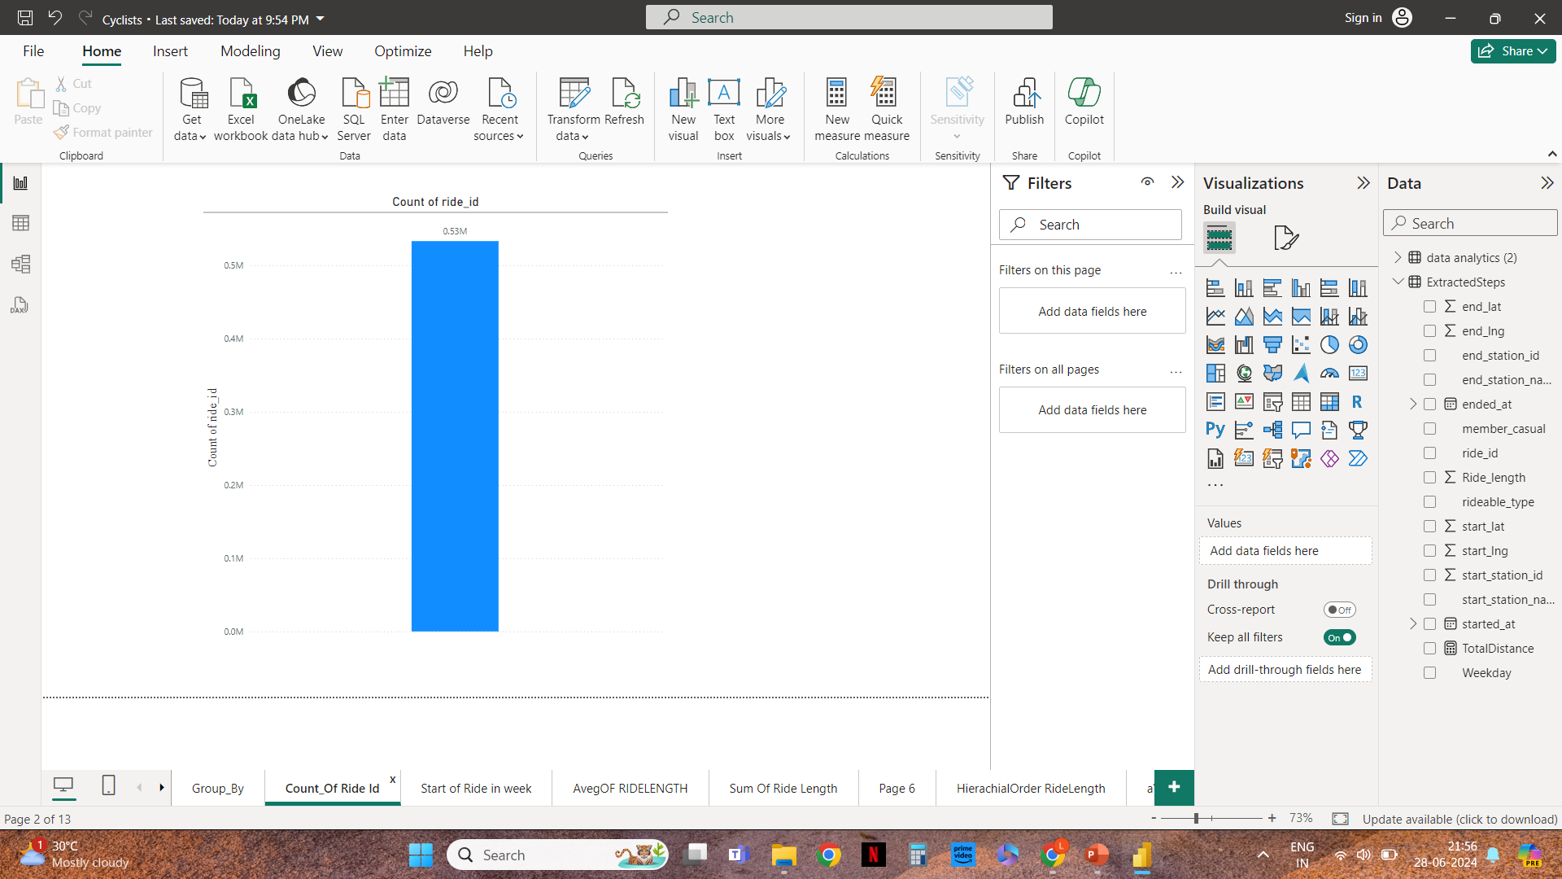
Count Of Ride Id

Slide 14
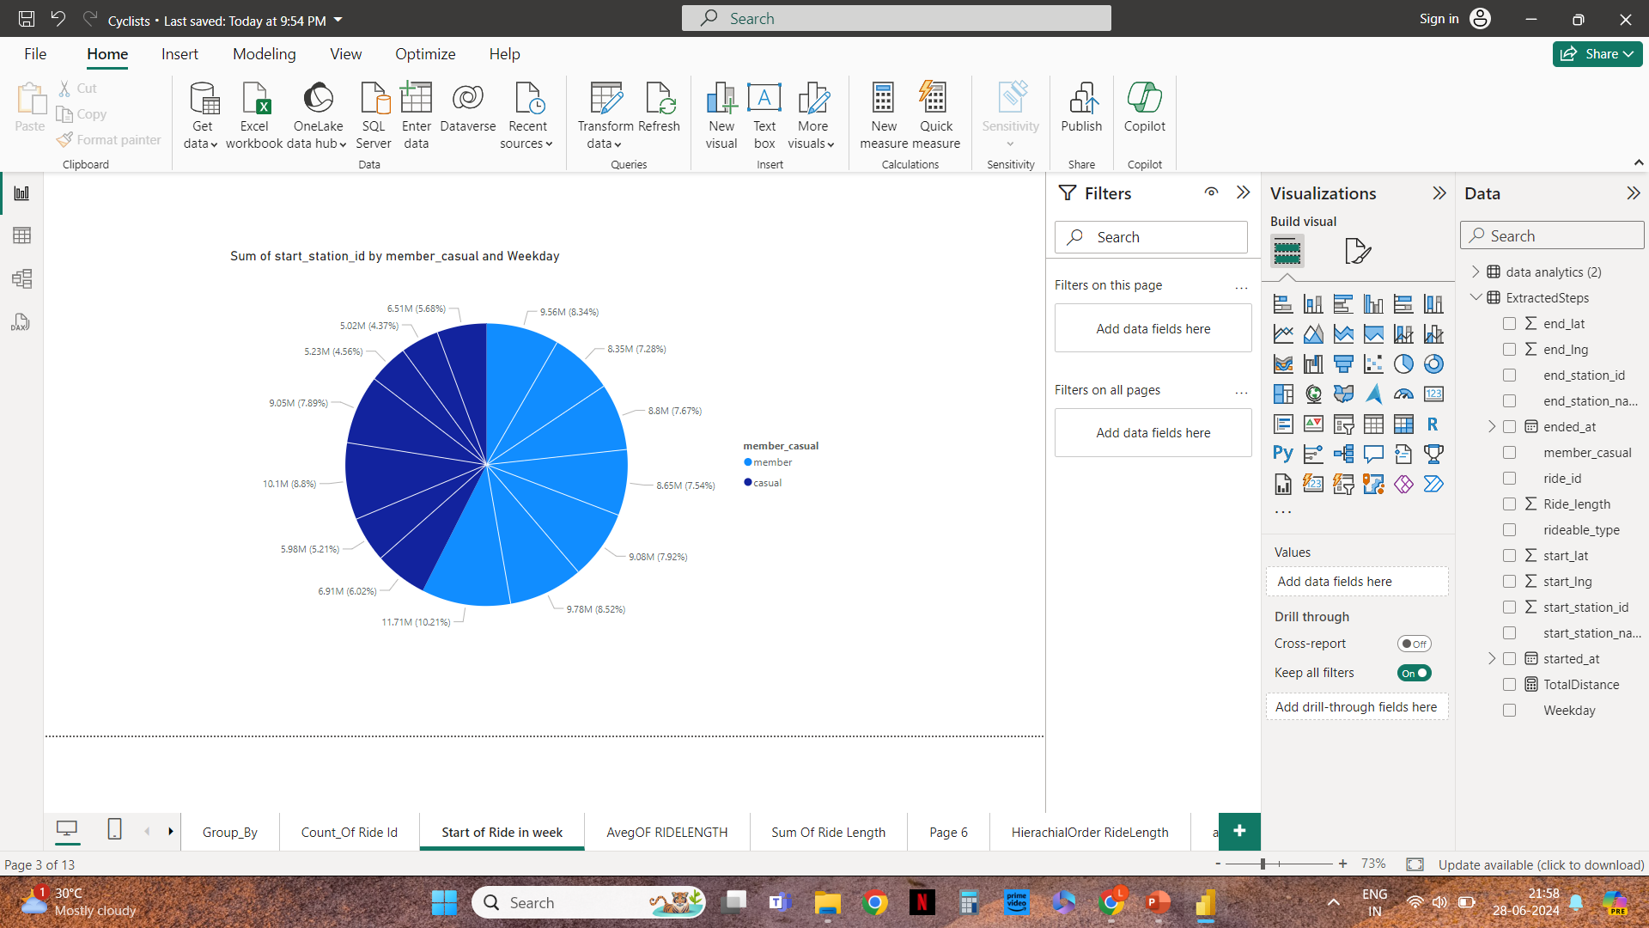
Start Station Of Member_Casual By Weekday

Slide 15
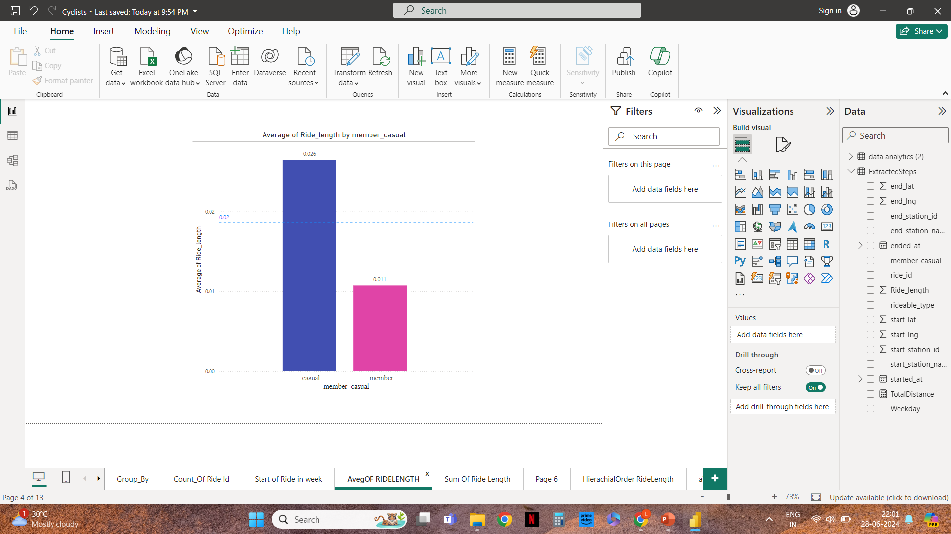
Average Of Ride_Length By Member_Casual

Slide 16
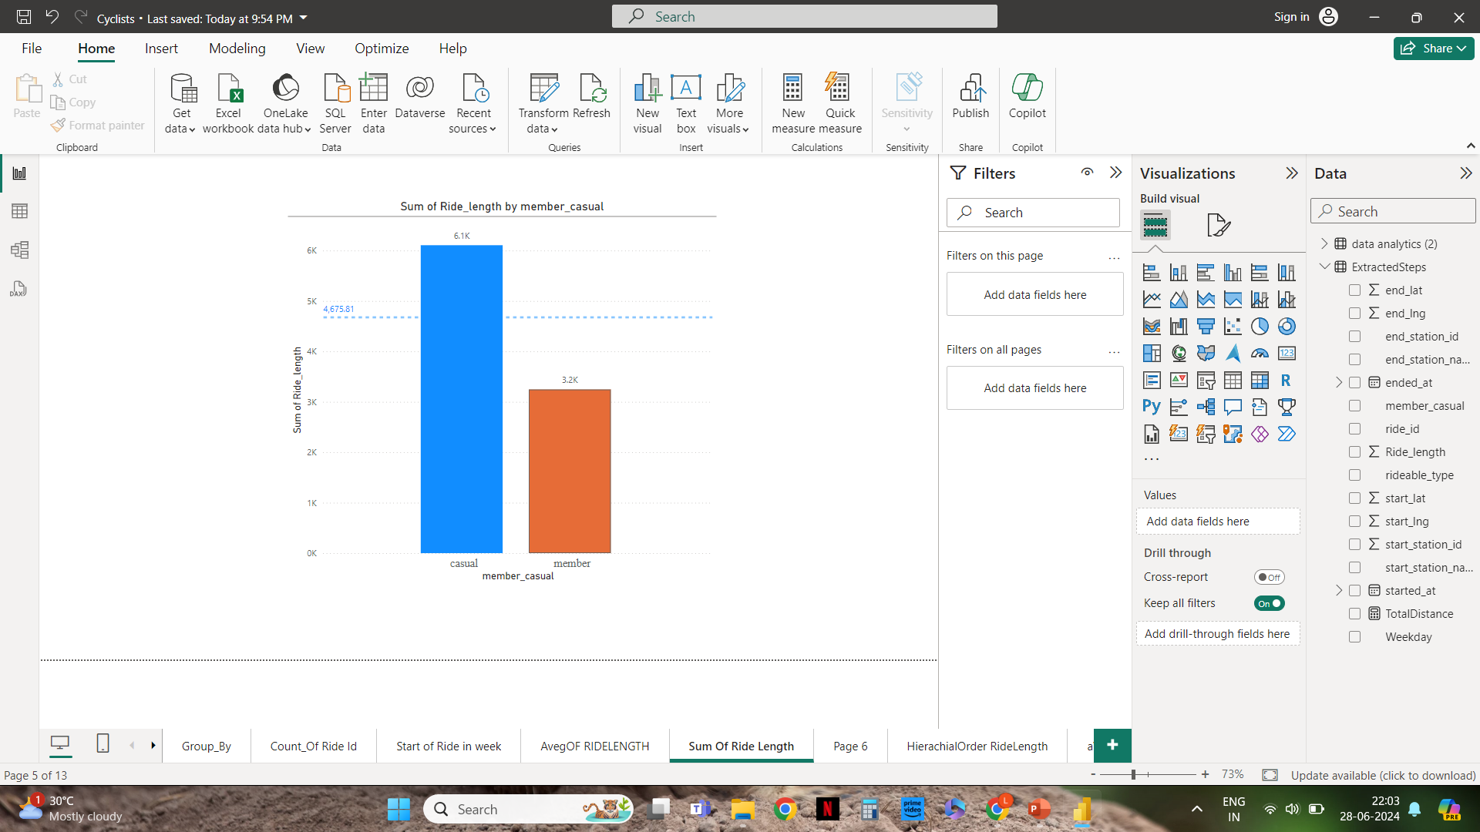
Sum Of Ride_Length By Member_Casual

Slide 17
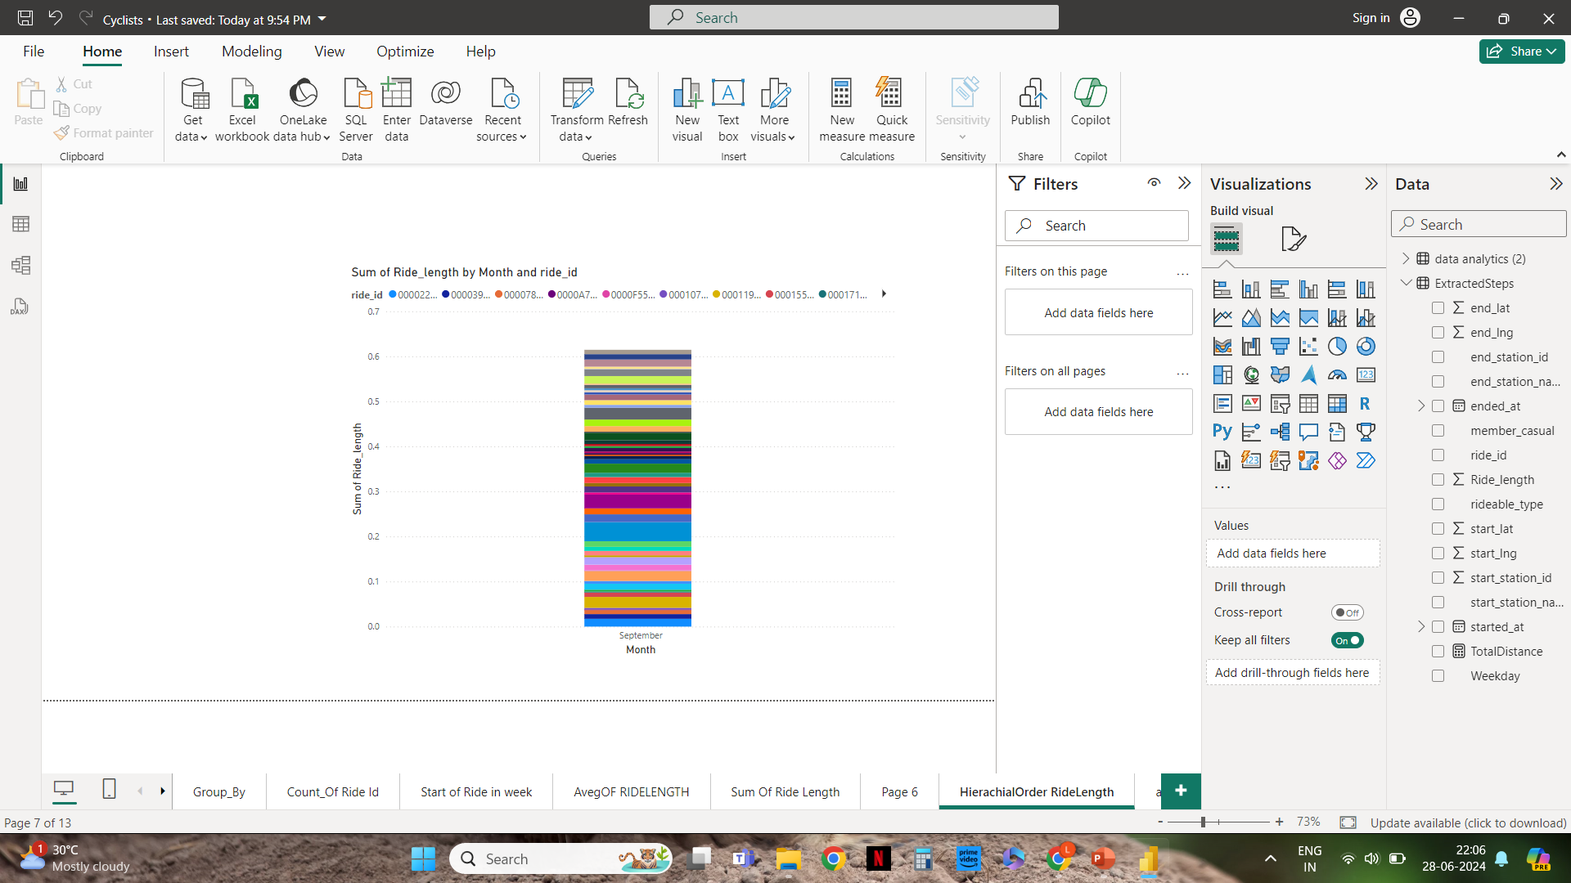
Hierarchical Order RideLength

Slide 18
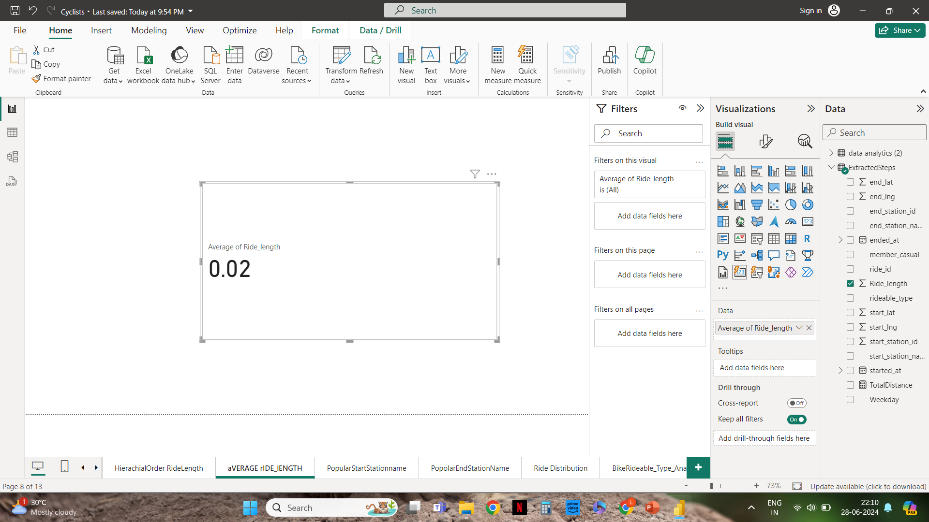
Average Of Ride Length Using Card Visualization

Slide 19
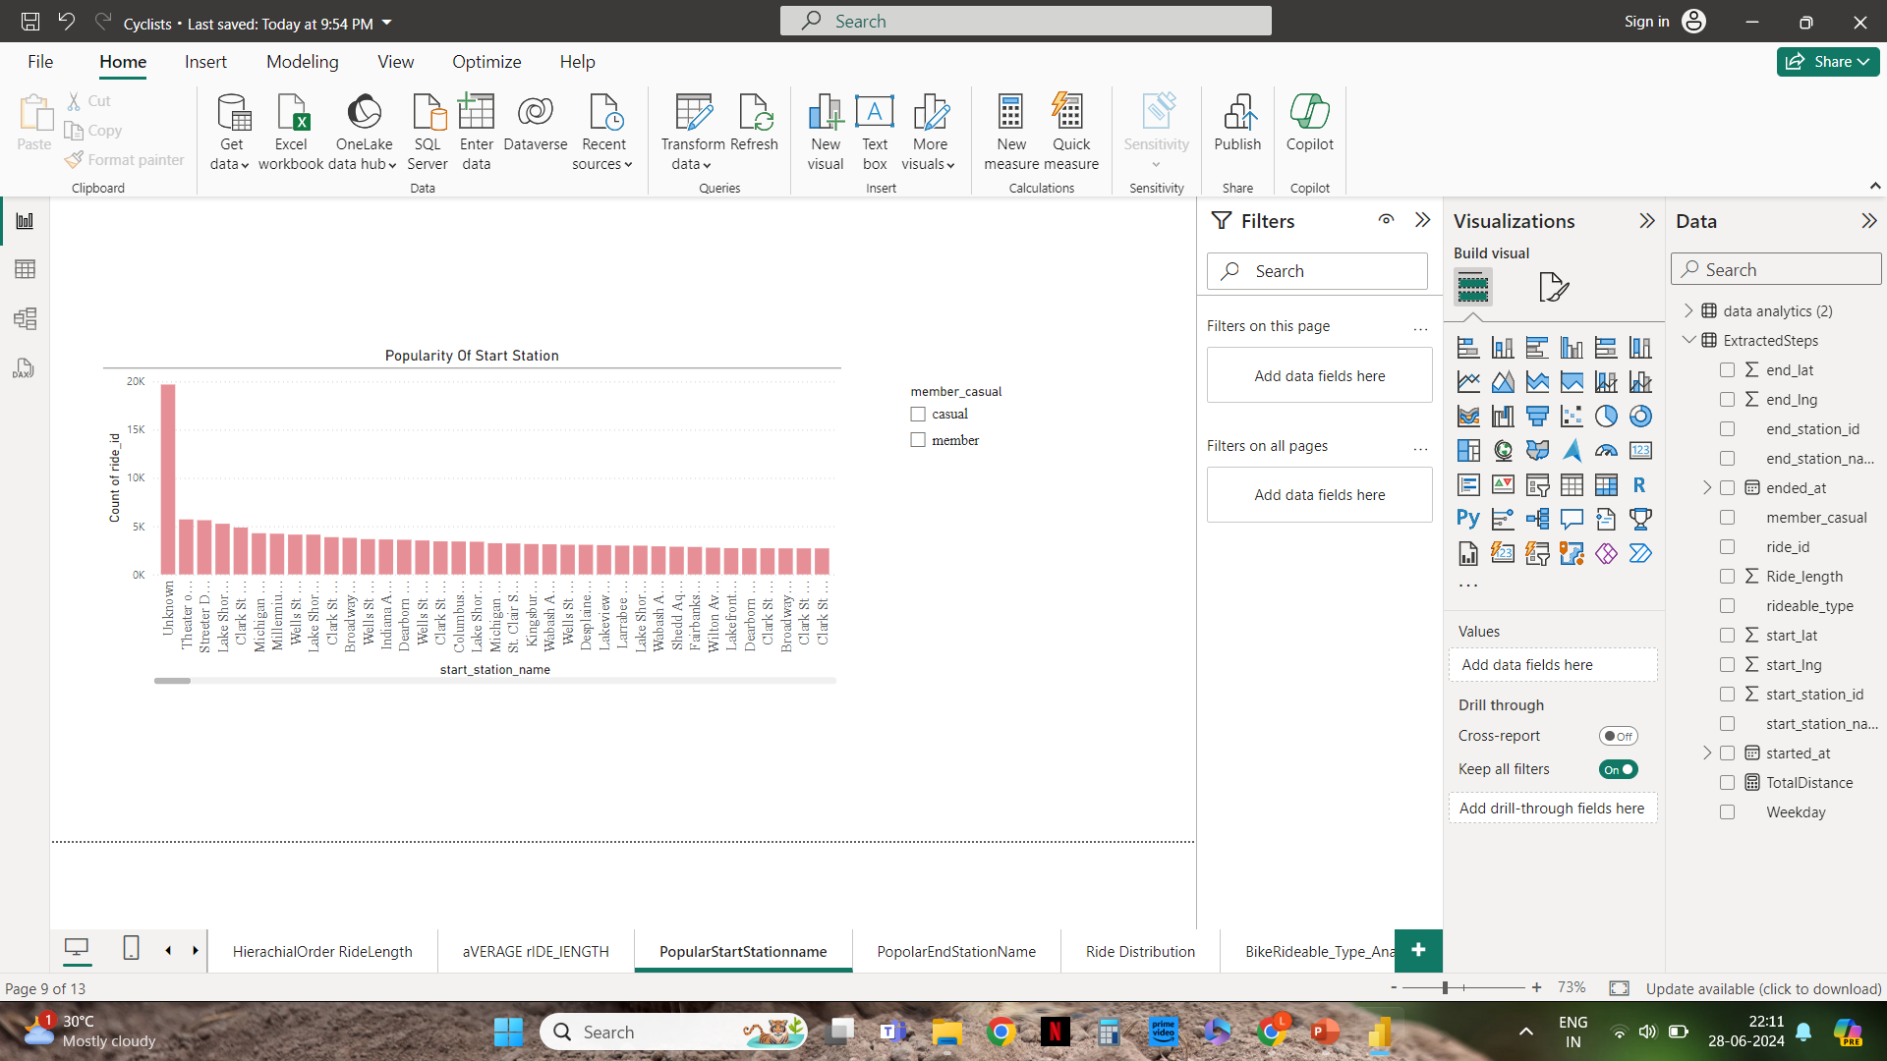
Popularity Of Start Station By Slicer

Slide 20
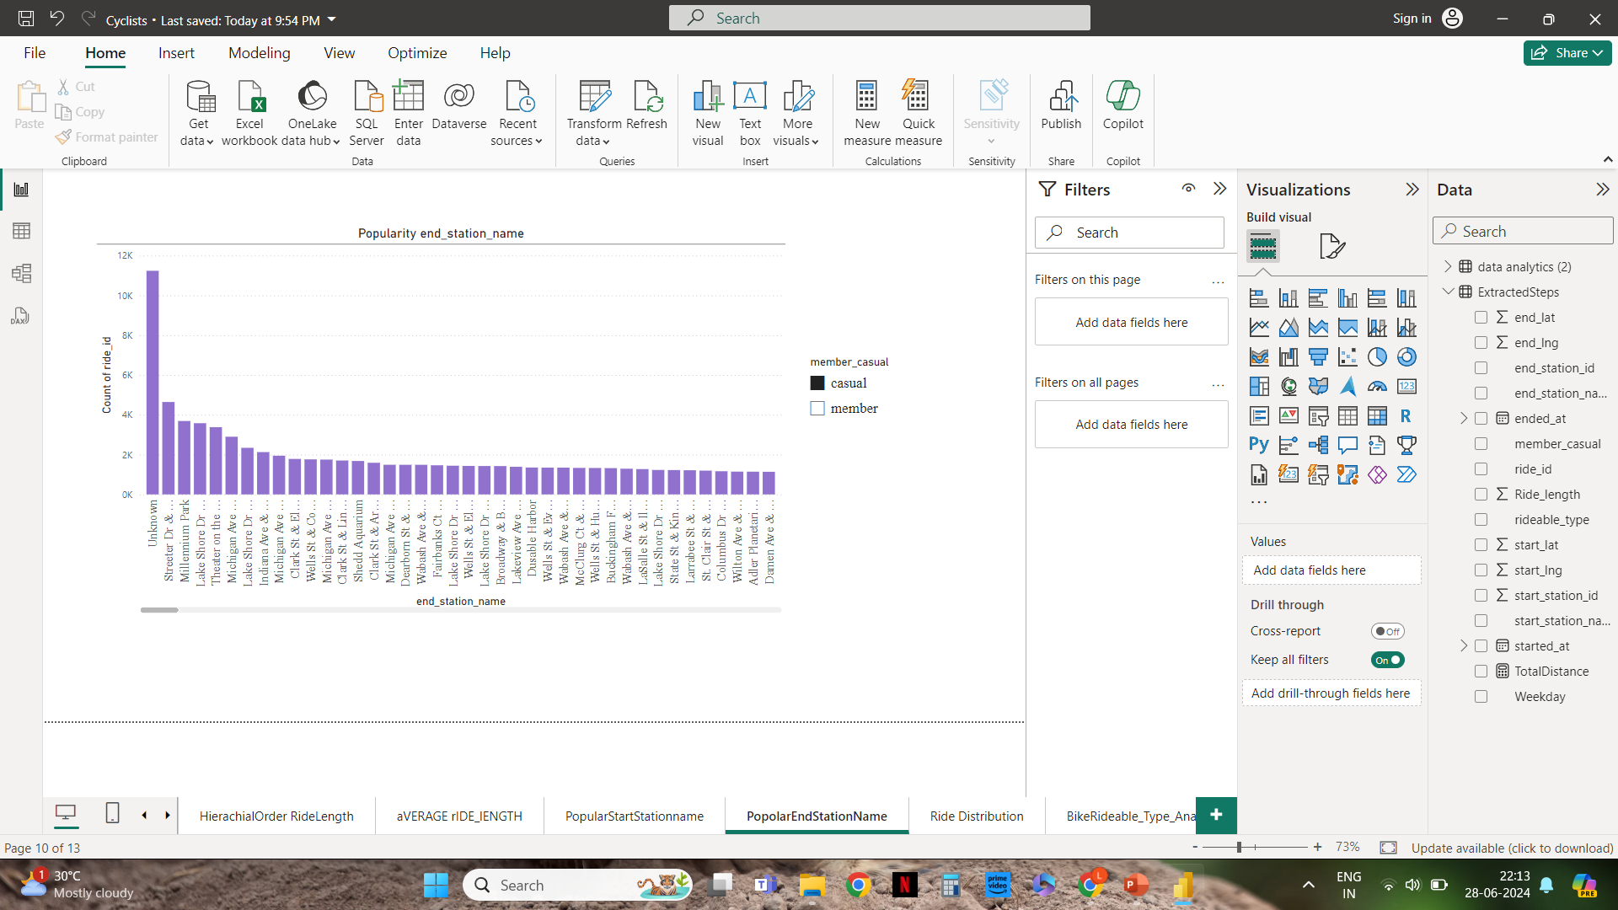
Popularity Of End Station By Slicer

Slide 21
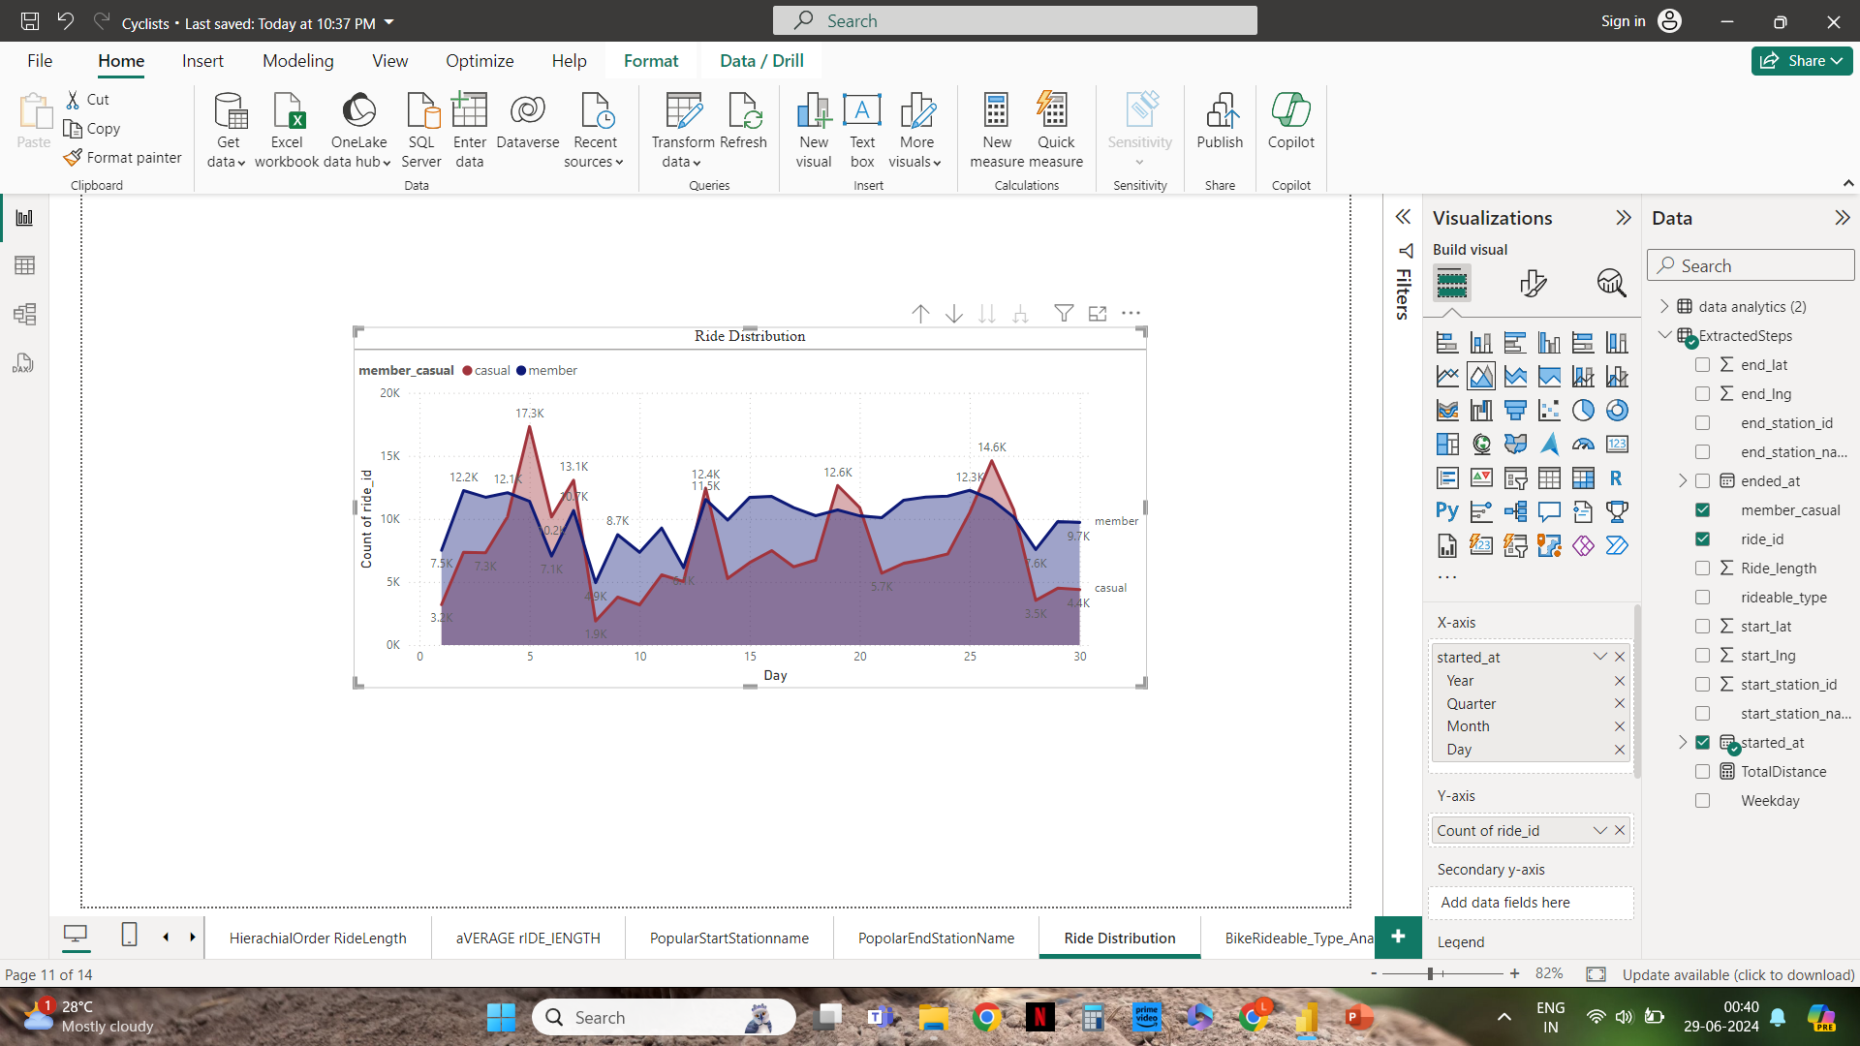
Ride Distribution

Slide 22
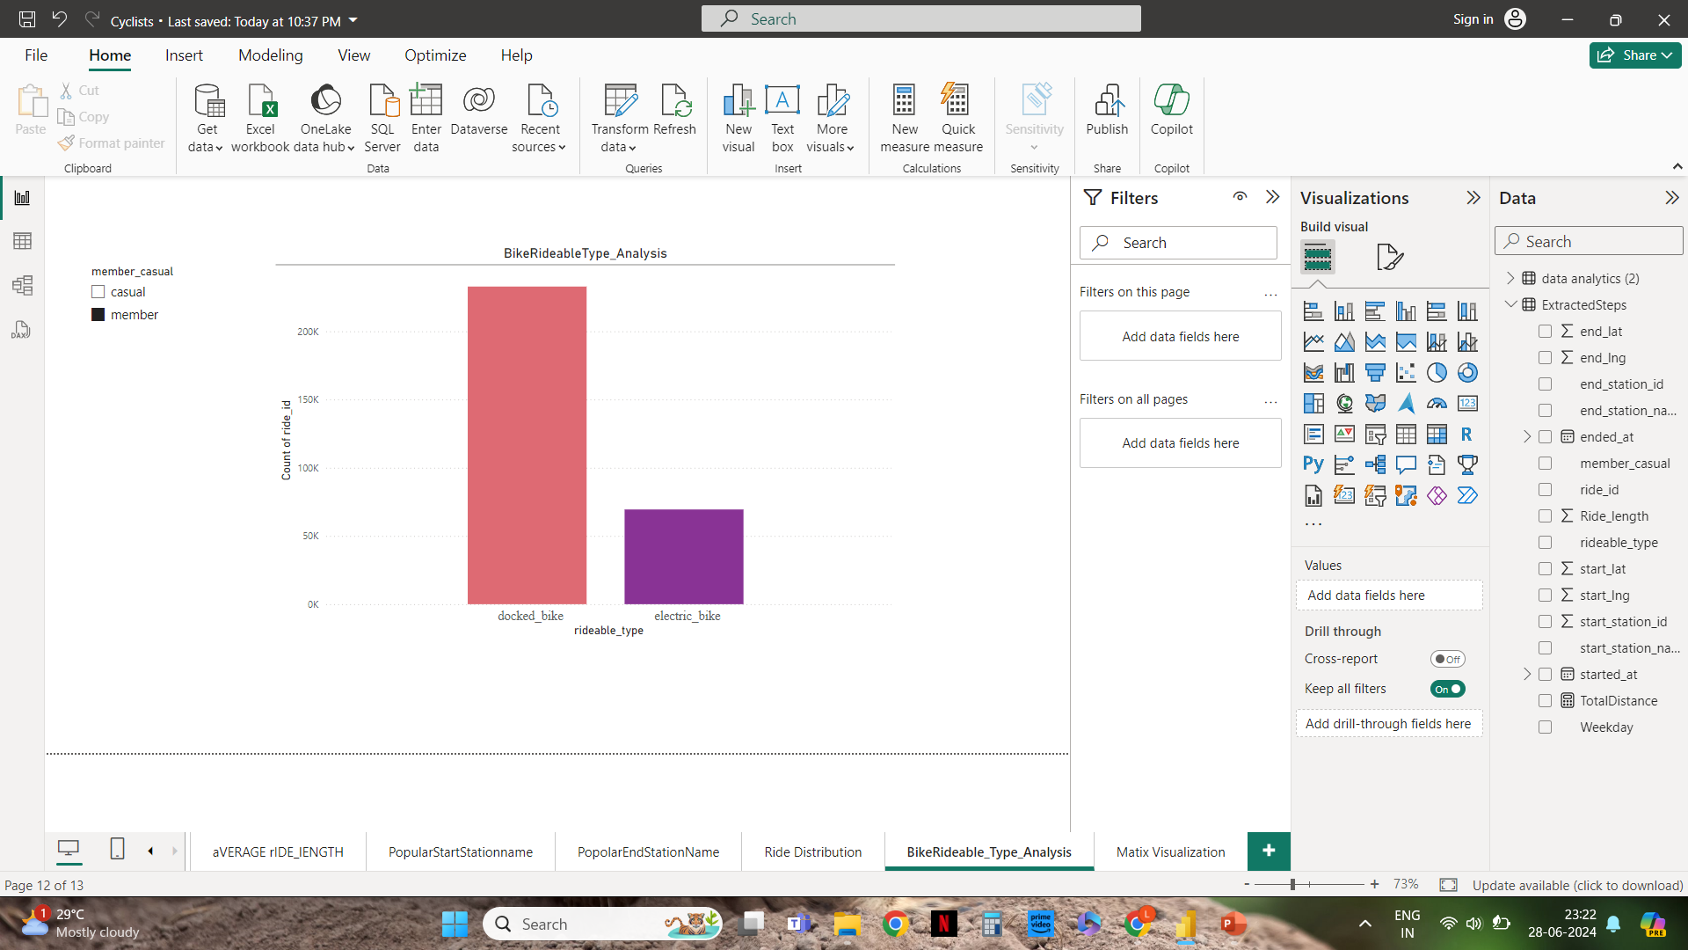
Bike_Rideable Type Analysis

Slide 23
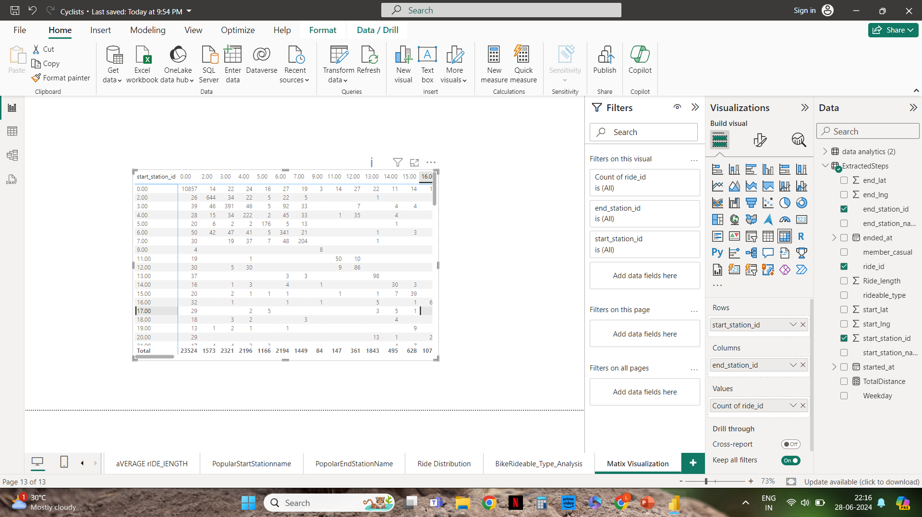
Matrix Visualization

Slide 24
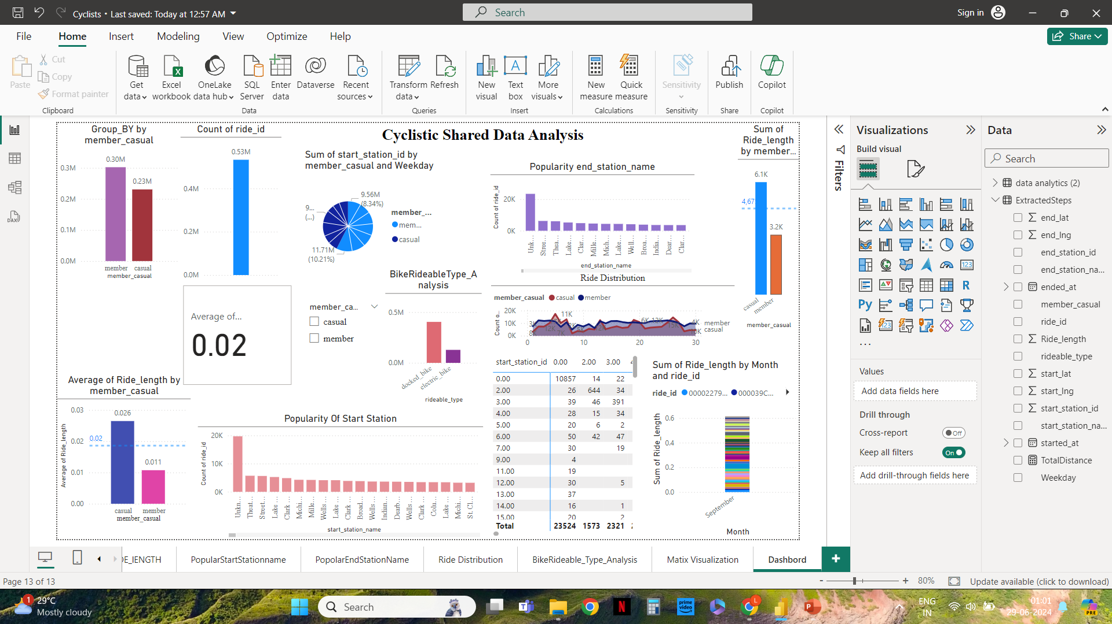
Dashboard

Slide 25
Key Findings
Popular Stations:
Certain stations are consistently popular as both start and end points.
High-traffic stations are often located near public transportation hubs, tourist attractions, and commercial areas.
Ride Length Patterns:
Casual riders tend to have longer ride durations compared to annual members.
Annual members show more consistent and frequent usage patterns, likely due to their commuting habits.
Bike Type Analysis:
Both Casual and Annual Members used Docked Bike Majorly.
Use of electric bike is reduced.

Slide 26
Your top three recommendations based on your analysis.
Popular Stations:
Recommendation:
Dynamic Rebalancing System: Implement a dynamic bike rebalancing system that ensures bikes are available at high-traffic stations, particularly during peak times. Use predictive analytics to forecast demand at popular start and end stations and redistribute bikes accordingly.
Increase Bike Capacity: Expand bike docking capacity at the most popular
stations to accommodate higher usage, especially during commuting hours.
This can reduce wait times and improve user satisfaction.
Monitor Station Utilization: Continuously monitor station utilization rates and
adjust bike distribution strategies in real-time. This can be achieved through an
integrated dashboard that provides live data on bike availability and station
usage.

Slide 27
Ride Length Patterns:
Recommendations:
Personalized Campaigns: Develop personalized marketing campaigns targeting casual riders. Highlight the cost savings, convenience, and benefits of annual membership, such as access to special promotions or events.
Incentive Programs: Introduce incentive programs for casual riders to encourage them to become annual members. Offer discounts on annual memberships or provide ride credits for signing up.
Trial Memberships: Offer trial memberships to casual riders to give them a taste of the benefits of being an annual member. This can include a month of free membership or a significant discount for the first few months.

Slide 28
Bike Type Analysis:
Recommendation:
Electric Bike Awareness and Accessibility: Promote the benefits of electric bikes (e-bikes) through marketing campaigns and improve their accessibility by ensuring they are available at strategic locations. Consider offering incentives for using e-bikes, such as discounted rates or loyalty points.

Slide 29
Thank You

